Slide 1
Git & Maven Training

Slide 2
AGENDA
Git
What is Git?
Main Concepts
Basic Commands
Setup and Configuration
Demonstration
Maven
What is Maven?
Maven Commands
Project Structure
POM Files
Dependency Management
Setup and Configuration
Demonstration

Slide 3
AGENDA
Git
What is Git?
Main Concepts
Basic Commands
Setup and Configuration
Demonstration
Maven
What is Maven?
Maven Commands
Project Structure
POM Files
Dependency Management
Setup and Configuration
Demonstration

Slide 4

GIT – What is Git?
Git is a version control system used for tracking changes of any set of files.
Its main advantages are that it coordinates the work of multiple programmers during software development, speed, data integrity and parallelism.
Why use Git?
It’s a safe and easy way to store your project remotely
Multiple programmers have access and can work on the project in parallel
Helps you keep track of all the changes to the project
You can always roll back to previous versions of the code, if needed

Slide 5
AGENDA
Git
What is Git?
Main Concepts
Basic Commands
Setup and Configuration
Demonstration
Maven
What is Maven?
Maven Commands
Project Structure
POM Files
Dependency Management
Setup and Configuration
Demonstration

Slide 6
GIT – Main Concepts
In order to function, Git uses multiple concepts. The main we will talk about are repositories, branches, commits, merging and conflicts
Repository
A repository is the workspace of a project. It contains the projects code as well as all the branches, commits and pull requests that have been created. Repositories can be categorized as follows:
Public – anyone can read the code and the history of changes
Private – read access is granted only by the owners
Remote – stored on a remote server.
Local – a local copy of a remote repository. While working, every developer will have its own local copy of the repo.
The local and remote repositories aren’t automatically synchronized

Slide 7
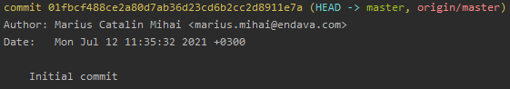
GIT – Main Concepts
Commit
The commit is the fundamental concept of Git. Any code changes are wrapped in a commit.
A commit contains the name of its author, the date at which the commit was created, a message to easily understand what was changed in that commit and the actual changes to the code.
Example of a commit in the terminal

Slide 8
GIT – Main Concepts
Branch
A branch is an independent line of commits. When a branch is created, it will ‘inherit’ the commits of its ‘parent’ branch at that moment. Commits added to the ‘parent’ branch will not be added to the ‘child’ branches and commits added to the ‘child’ branches will not be added to their ‘parent’ branches. Just like repositories, branches can be local and remote as well and they are not automatically synchronized.
For example, in the second figure, branch A initially contained only the commit 1 when branch B was created. Commits 2 and 3 that were added to branch A were not added to branch B.
Thus, branch A contains commit 1, 2 and 3, while branch B contains commit 1, 4 and 5.
3
5
Commits
2
4
1
Branch B
Branch
Branch A
Fig. 1
Fig. 2

Slide 9
GIT – Main Concepts
Branch – part 2
Every repository will have a ‘main’ or ‘master’ branch. That is a branch that does not have a parent branch and any other branches start from it either directly or indirectly.
Also, important branches can be protected. This means that they cannot be pushed to. In order to add commits to a protected branch, your changes must be merged through a merge request. This ensures that all changes made in these branches will be reviewed and double-checked in order to ensure consistency and stability.

Slide 10
GIT – Main Concepts
Merging
Merging represents the integration of the commits of one branch in another branch, essentially merging them into one. After merging, the branch will contain all the code changes that both branches contained. After the merge, a merge commit will be created on the branch into which we merge.
Merging can be done via the ‘git merge’ command or through the UI, via a merge request.
A merge request represents the intent of merging two branches and it is a way of others to review your code.
A
1
2
4
8
Fig. 1 shows a scenario in which we perform merges between three branches. Commits 7 and 8 are merge commits, so branch A will contain the changes made in all commits, except commit 9, since branch C was merged before commit 9 was made.
Merging a branch will not automatically delete it.
B
3
5
7
C
6
9
Fig. 1

Slide 11
GIT – Main Concepts
Conflicts
When two branches diverge, they can have different modifications of the same line of code. If those two branches were to be merged, Git will be unable to determine which version of the changes we want to keep, thus creating a conflict. Conflicts can occur when merging two different branches as previously demonstrated, but they can also occur when synchronizing a remote branch with a local one, if a line is changed differently both on the remote and local branches.
Solving a conflict is done by manually choosing which one of the two versions of the code we want to keep.
A
1
2
8
Fig. 1 shows a scenario in which a merge conflict could appear if both commits 2 and 3 change the same line of code.
B
3
Fig. 1

Slide 12
AGENDA
Git
What is Git?
Main Concepts
Basic Commands
Setup and Configuration
Demonstration
Maven
What is Maven?
Maven Commands
Project Structure
POM Files
Dependency Management
Setup and Configuration
Demonstration

Slide 13
GIT – Basic Commands
In order to properly understand and use Git, we will explore the main terminal commands used during development.
git config – used to configure the Git client, specifying your name and email address
git clone <repository-link> - clones (copies) a remote repository locally. This command will create a new folder named after the repository and will download its files inside the folder.
git fetch – downloads the commits and files from the remote repository
git pull – downloads and integrates the changes from the remote repository for the current branch, synchronizing them
git status – shows what modifications have been made to the code on the current branch and if the local branch is up to date with the remote one
git add <file-name> – adds the changes done to the file <file-name> to the list of changes that will be committed
git restore <file-name> – discards the changes made do the file <file-name>. If used with parameter ‘--staged’, it will only remove the specified files from the list of changes to be committed.
git stash <file-names> – creates a stash with the changes made to the specified files, restoring them to their original state
git stash apply / pop – applies the changes saved in the latest created stash. Using the ‘pop’ parameter will delete the stash

Slide 14
GIT – Basic Commands
git commit – commits the changes added using the ‘git add’ command. This command creates a new commit on the local branch. The commit must contain a message that can be specified using the –m “<commit-message>” parameter
git push – pushes the commits from the local branch to the remote branch
git log – shows the list of commits on the current branch. Can be used with the ‘--graph’ parameter to show a tree-like history of the commits.
git checkout <branch-name> - switches from one branch to another. This command can also create a new branch from the current one with the help of the parameter ‘-b’
git branch <branch-name> – creates a new branch. This command can also be used to delete a branch with the help of the parameter ‘-d’
git rebase <branch-name> – rebases the commits of the current branch with the commits of the <branch-name> branch. If we specify the parent branch, then this will bring any new commits on the parent branch to the child branch as well. Also, this command can be used to go through all the commits on the branch and delete or ‘squash’ them by using the ‘git rebase -i <commit-reference>’ syntax.
git merge <branch-name> – merges the branch <branch-name> into the current branch
git cherry-pick <commit-hash> – adds the commit identified by its hash to the current branch

Slide 15
AGENDA
Git
What is Git?
Main Concepts
Basic Commands
Setup and Configuration
Demonstration
Maven
What is Maven?
Maven Commands
Project Structure
POM Files
Dependency Management
Setup and Configuration
Demonstration

Slide 16
GIT – Setup and Configuration
In order to configure the Git, you first must install a Git client and configure it through the git config command.
A repository can also be configured by setting the main branch, making branches protected and adding a .gitignore file.
The .gitignore file specifies which files we want stored in the remote repository and which we don’t. For instance, there is no use to store the “target” folder, as these files will be generated locally anyway, and it would just clutter up the merge requests when reviewing the changes.
The .gitignore contains rules for excluding files from the repository based on path, extension and file name.

Slide 17
GIT – Setup and Configuration
Download and install Git Bash from https://git-scm.com/
Add ‘C:\Program Files\Git\cmd’ to your environment variable ‘PATH’
Log into GitLab at https://gitlab.com/ with your Endava credentials
Open Git Bash and run the commands: git config --global user.name “Your name“ git config --global user.email “Your email“
Navigate with the Git Bash terminal to the location you want to download the repository.
Run the command: git clone https://gitlab.com/endavatrainings2021/gittraining.git
Rejoice as you have now successfully cloned the repo!
☺

Slide 18
AGENDA
Git
What is Git?
Main Concepts
Basic Commands
Setup and Configuration
Demonstration
Maven
What is Maven?
Maven Commands
Project Structure
POM Files
Dependency Management
Setup and Configuration
Demonstration

Slide 19
GIT – Demonstration
How to create a branch?
How to create and push a commit?
How do I remove my local changes?
How to merge a branch?
How to get a commit from another branch?
How to combine (squash) two commits?
How to remove a commit?
How to fix a conflict?
How to create a pull request?
The merge request says that my branch is out of date. What to do?
How to rebase a branch?

Slide 20
GIT – Assignment
Clone the repo located here
Create your own branch named “<last-name>_<first-name>_assignment from the master branch
Create a new file (name, extension or content does not matter) and commit it
Edit the readme file and commit the change
Create a file named Conflict.txt and add some text in it. Commit the new file.
Push your changes
Squash your first two commits
Cherry pick the commit which created the “cherry.txt” file on the branch “mihai_catalin_assignment”
Push your changes
Create a merge request to merge your branch into the “second_branch” branch. Add me as a reviewer and fix the conflicts. Do not merge it.

Slide 21
Time for a short break!

Slide 22
AGENDA
Git
What is Git?
Main Concepts
Basic Commands
Setup and Configuration
Demonstration
Maven
What is Maven?
Maven Commands
Project Structure
POM Files
Dependency Management
Setup and Configuration
Demonstration

Slide 23

Maven – What is Maven?
Based on its own documentation, Apache Maven is a software project management and comprehension tool. Based on the concept of a project object model (POM), Maven can manage a project's build, reporting and documentation from a central piece of information.
Simply put, Maven helps in building the projects through its own build steps. It can easily resolve, download and integrate the projects dependencies, compile the source code, run the projects tests and publish its artefacts.
Why use Maven?
Easy dependency management
Compile the project, run the tests and publish the artefacts with one command
Integrate plugins easily
Generating snapshot versions of artifacts
Report generating (i.e. code coverage)

Slide 24
AGENDA
Git
What is Git?
Main Concepts
Basic Commands
Setup and Configuration
Demonstration
Maven
What is Maven?
Maven Commands
Project Structure
POM Files
Dependency Management
Setup and Configuration
Demonstration

Slide 25
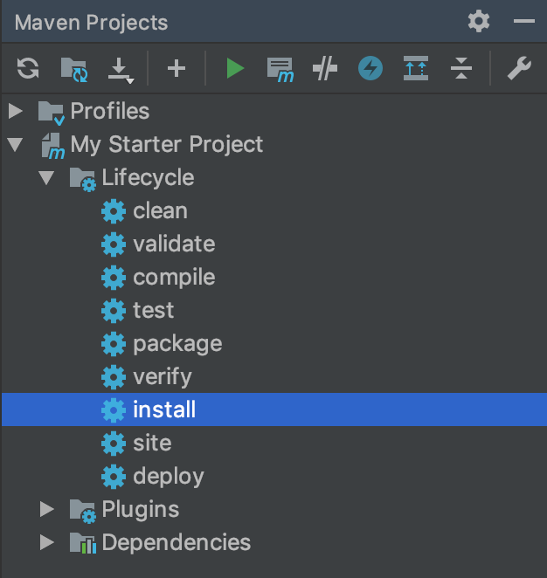
Maven – Maven Commands
Maven uses lifecycle phases or steps that clearly define the process of building and distributing an artifact:
mvn clean – performs the project cleanup, such as deleting the “target” folder
mvn validate – validate the project is correct and all necessary information is available to complete a build
mvn compile – compiles the source code of the project, generating the targets
mvn test – runs the projects tests
mvn package – packages the compiled code in a distributable format, for example a .JAR file
mvn verify – run any checks on results of integration tests to ensure quality criteria are met
mvn install – install the projects package into your local repository, so you can include it as a dependency in other local projects
mvn deploy – deploys the artifacts to remote repositories so other developers can use it

Slide 26
AGENDA
Git
What is Git?
Main Concepts
Basic Commands
Setup and Configuration
Demonstration
Maven
What is Maven?
Maven Commands
Project Structure
POM Files
Dependency Management
Setup and Configuration
Demonstration

Slide 27
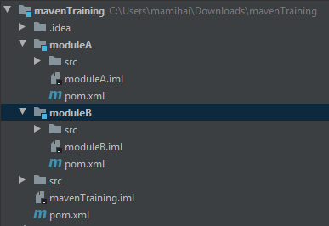
Maven – Project Structure
A Maven project is characterized by its .POM file. Also, a Maven project can contain modules which are themselves Maven projects, thus creating a tree-like structure of inheritance.
Inheritance is important since child modules inherit the parents' dependencies and properties, so dependencies and properties used across all modules can be extracted in the parent module to avoid duplication and to easily manage.
For instance, in figure 1 we have a parent project called ‘mavenTraining’, with its own sources folder and pom file, and two child modules, ‘moduleA’ and ‘moduleB’ that have their own sources and poms.
Any properties and dependencies that mavenTraining have will be inherited by its children modules.
Fig. 1

Slide 28
AGENDA
Git
What is Git?
Main Concepts
Basic Commands
Setup and Configuration
Demonstration
Maven
What is Maven?
Maven Commands
Project Structure
POM Files
Dependency Management
Setup and Configuration
Demonstration

Slide 29
Maven – POM Files
A POM file is an XML file that defines a Maven project. Among many others, the POM files include:
Group id, artifact id and version used to identify the project within a repository. This way other projects can use ours as a dependency.
Information about the project, like a name, description, license, contributors
Packaging instructions that tell Maven how to package our project (POM, JAR, WAR, etc)
The list of modules that the project includes and the projects’ parent (if it has one)
The projects dependencies identified by their group ids, artifact ids and versions
The projects build settings, like the plugins to use to build the projects

Slide 30
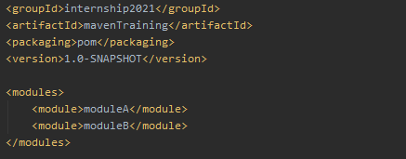
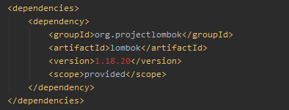
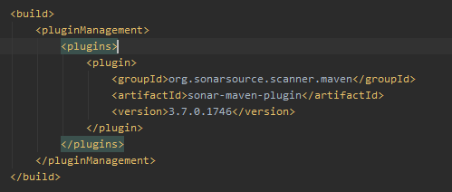
Maven – POM Files
Examples
The projects dependencies
Projects information as well as its modules
The projects plugins

Slide 31
AGENDA
Git
What is Git?
Main Concepts
Basic Commands
Setup and Configuration
Demonstration
Maven
What is Maven?
Maven Commands
Project Structure
POM Files
Dependency Management
Setup and Configuration
Demonstration

Slide 32
Maven – Dependency Management
Projects almost always have dependencies on other projects like libraries and frameworks.
The classical way of bringing a dependency into your project would be to manually download and copy the .JAR file of the library into your own project. This can be both unsafe and time consuming.
Maven solves this by simplifying the process. In order to add a new dependency, its group id, artifact id and version is required. Maven will search its configured repositories for the dependency and integrate it with the project.
A dependency might require itself a dependency and Maven will download that as well. This is called transitive dependency.
Multiple dependencies to the same project but with different versions may cause conflicts.
Example of dependency

Slide 33
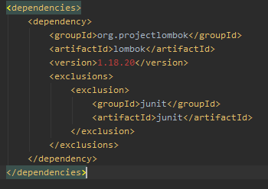
Maven – Dependency Management
A dependency has the following properties:
A group id that identifies its developer
An artifact id that identifies the developers project
The version of the dependencies artifact we want to get
A scope which can limit the dependency transitivity. These are:
compile - default, include dependencies in all classpaths. This dependency will be propagated to dependent projects.
provided - same as compile, but we expect the JDK or a container to provide it.
runtime - means that the dependency is not required at compile, just at run time
test – the dependency is needed only for test compilation and execution, and it will not be transitive
We can exclude a transitive dependency by using the <exclusions> tag. Excluded transitive dependencies are also identified by group and artifact ids.
All dependencies are stored in the Mavens .m2 folder.

Slide 34
AGENDA
Git
What is Git?
Main Concepts
Basic Commands
Setup and Configuration
Demonstration
Maven
What is Maven?
Maven Commands
Project Structure
POM Files
Dependency Management
Setup and Configuration
Demonstration

Slide 35
Maven – Setup and Configuration
Download and install the Java JDK from the Oracle website
Set the ‘JAVA_HOME’ environment variable to C:\Program Files\Java\<your-jdk>
Add %JAVA_HOME%\bin to your PATH variable.
Run the ‘java –version’ command and check that your Java installation is working
Download and extract Maven from the Apache Maven website
Set the M2_HOME variable to the installation folder
Add the ‘<maven-location>/bin’ folder to the PATH variable
Run the ‘mvn --version’ command and check that Maven is working
Congrats! You have both Java and Maven fully functional!
☺

Slide 36
AGENDA
Git
What is Git?
Main Concepts
Basic Commands
Setup and Configuration
Demonstration
Maven
What is Maven?
Maven Commands
Project Structure
POM Files
Dependency Management
Setup and Configuration
Demonstration

Slide 37
Maven – Demonstration
How to create a Maven project?
How to add a module to the Maven project?
How do I declare a property?
How to add a dependency to my project?
How to build my project?
How can I fully build the project without running the tests?
Where are the dependencies of my project stored?

Slide 38
Maven – Assignment
Clone the repo located here
Create your own branch named “<last-name>_<first-name>_assignment from the master branch
This repo is almost empty. Create a Maven project in it.
Add at least one compile and test scoped dependencies. Use them in your code to make sure it worked. Compile and run the tests using ‘mvn install’.
Extract the dependencies versions in properties. Name them like dependency.name.version.
Create a Maven module inside your project. Use the dependencies in it as well, to test inheritance.
Create a .gitignore file in which you ignore all generated files (the target folder, IntelliJ folders)
Commit and push your changes
Create a merge request to merge your branch into the “master” branch. Add me as a reviewer and fix the conflicts. Do not merge it.

Slide 39
THANK YOU!
MARIUS CATALIN MIHAI
JAVA DEVELOPER

